Slide 1
BLOOD GROUPS

Slide 2
Objectives
1. To determine the blood group according to the ABO system.
2- To test for the availability of the Rh factor (D antigen)

Slide 3
Blood Group Substances
The differences in human blood are due to the presence or absence of certain protein molecules called antigens and antibodies.
The antigens are located on the surface of the red blood cells
Antigens are also found in a wide variety of tissues and biological fluids such as saliva, milk , seminal fluid, urine , and gastric juice.
The antibodies are in the blood plasma to attack foreign antigens, resulting in clumping (agglutination)

Slide 4
ABO Blood Type System
-The ABO blood type system is the major blood type classification system.
- The four blood types in the ABO system (A, B, AB, and O) refer to different versions of oligosaccharides which are present on the surface of RBCs.

Slide 6
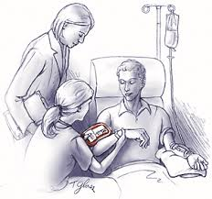
Importance of The ABO System
Blood group antigens must be determined to secure a safe practice of blood transfusion.
They are also useful in determining familial relationships in forensic medicine.

Slide 7
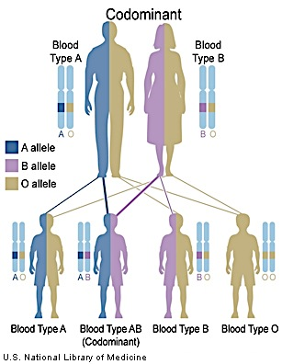
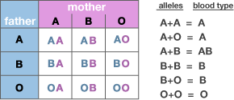
Genetics of Blood Types
Your blood type is established before you are born, by specific GENES inherited from your parents.
You have two copies of this gene, one inherited from your MOTHER and the other inherited from your FATHER.

Slide 8
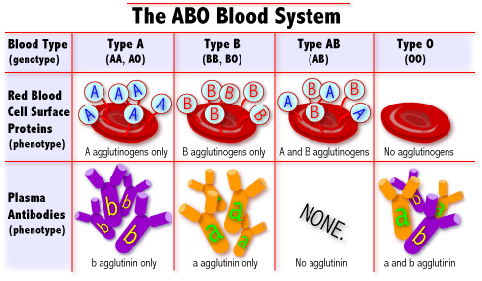
Blood Types
There are 3 alleles or genes for blood type: A, B, & O.
Since we have 2 genes, there are 6 possible combinations.

Slide 10
Rhesus Blood Group
First studied in rhesus monkeys.
Is the second most significant blood group system in human transfusion.
The D antigen (RhD) is the most important.
If it is present on RBCs’ surface, the blood is RhD positive (~80% of the population), if not it's RhD negative.
So, for example, some people in group A will have it, and will therefore be classed as A+ (or A positive), while the ones that don't, are A- (or A negative) and so it goes for groups B, AB and O.

Slide 11
Rh Blood Group Transfusion
A person with Rh+ blood can receive blood from a person with Rh- blood without any problems
A person with Rh- blood can develop Rh antibodies in the blood plasma if he or she receives blood from a person with Rh+ blood, whose Rh antigens can trigger the production of Rh antibodies

Slide 12
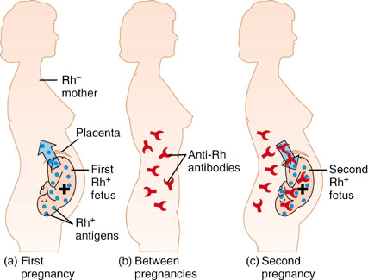
Hemolytic Disease of The Newborn (HDN)
Also called, Erythroblastosis Fetalis
Mother is Blood type Rh-, Father and fetus are Rh+
First pregnancy = sensitization at delivery due to hemorrhage
Second pregnancy = Mother produce anti-Rh IgG antibodies that cross placenta to attack fetal RBCs leading to hemolysis

Slide 13
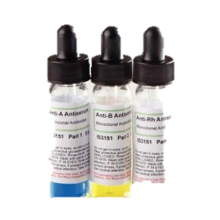
Principle Of Test
Type B blood gp
Anti B antibodies
Agglutination
Hemolysis
Seen as the picture

Slide 14
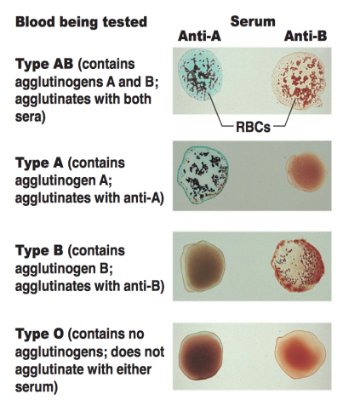
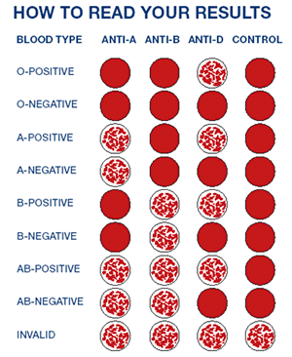
Results

